Slide 1
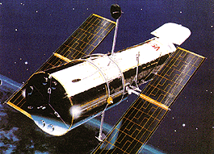
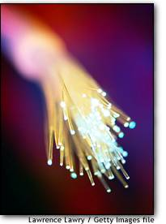
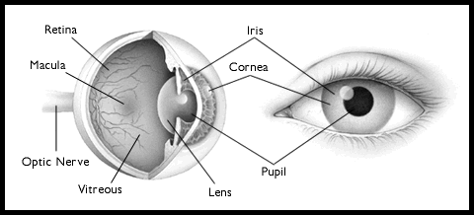
Chapter 40 (partial Capt.39)
Geometrical Optics (几何光学)
Ciliary Muscles

Slide 2
40-1 Introduction
Optics (光学): the study on the properties of light and its propagation through various materials.
Application:
Traditional applications: Telescopes, Microscopes
Modern applications: Information storage and retrieval
CD players, supermarket bar-code
Signal transmission through optical fiber cables
Geometrical Optics (几何光学): the case in which light travels in straight line and encounters objects whose size is much larger than λ.
Words: mirrors(反射镜), lenses(透镜), prisms(棱镜)
Wave Optics (or Physical Optical 物理光学): the passage of light through very narrow slits or around very narrow barriers, whose dimensions may be comparable to λ.
Words: reflection(反射), refraction(折射), interference(干涉), diffraction(衍射), polarization(偏振)

Slide 3
Geometric Optics
So far EM waves in vacuum
What happens to EM waves (usually light) in different materials?
  we must include κ_{e} in Maxwell’s Equations -----> index of refraction, n
Restriction: waves whose wavelength is much shorter than the objects with which it interacts.
Pretend that light propagates in straight lines, called rays.
Our primary focus will be on the REFLECTION and REFRACTION of these rays at the interface of two materials.
incident
ray
reflected
ray
MATERIAL 1
MATERIAL 2
refracted
ray

Slide 4
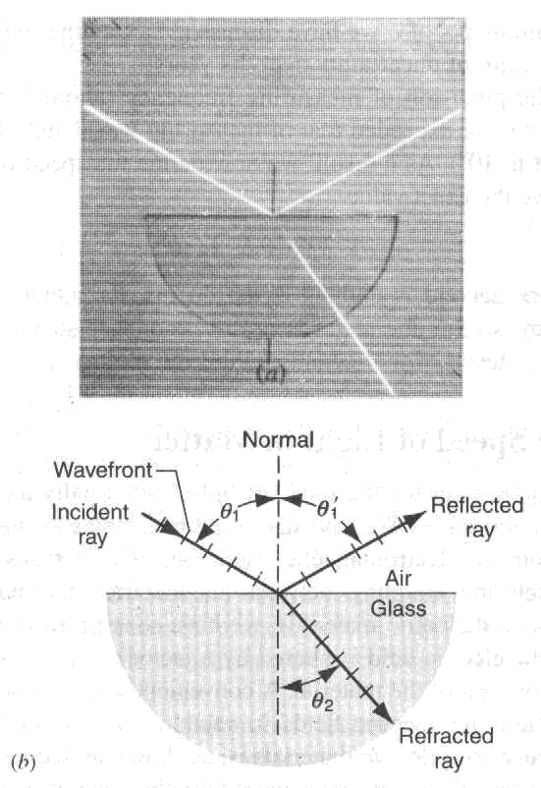
40-2 The basic law of geometrical optics
1. Three Laws of Geometrical Optics (几何光学三定律):
The law of straight line propagation of light
Light propagates in a straight line in a uniform materials(均匀材料).
The Law of Reflection:
The reflected ray lies in the plane
of incidence, and θ_{r}=θ_{I}
The law of Refraction:
The refracted ray lies in the plane
of incidence, and
n₁sinθ₁ = n₂sinθ₂

Slide 5
Reflection
The angle of incidence equals the angle of reflection θ _{i} =θ _{r} , where both angles are measured from the normal:
Note also, that all rays lie in the “plane of incidence”.
θ_{i}
θ_{r}
  Why?
    This law is quite general; we supply a limited justification when surface is a good conductor (reasonable restriction since reflection is dominant in this case)
First consider a wave hitting a conductor at normal incidence:
The electrons on the surface of the metal will experience a force F=eE → acceleration → radiation in .
e

Slide 6
Shedding Light on Reflection
By superposition (which works just as well for oscillating fields), the (total field) = (incident field) + (reradiated field).
But we know E_{tot} = 0 inside the conductor.
Therefore,
  The field created by the surface electrons completely cancels the incident field inside the conductor, and also is the “reflected” wave.
Now consider non-normal incidence
  The components of E parallel to the surface of the incident and reflected waves must cancel for the same reason!
E_{i}
E_{r}
θ _{i}
θ_{r}
θ_{i}
θ_{r}
x

Slide 7
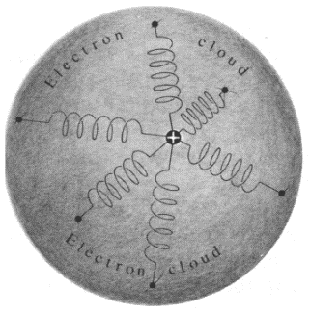
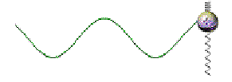
How does light interact with matter?
A simple description
“Charge on spring” description of electrons ‘bound’ to atoms in materials
Light interacts with matter by causing internal charges in the material to oscillate
light frequency
“natural” or “resonant” frequency of charge on spring
ω
ω_{o}
Due to inertia, “bound” charges in a material respond sluggishly to incident light
driven charges re-emit waves that are out of phase with incident wave

Slide 8

Index of Refraction(折射率)
The wave incident on an interface can not only reflect, but it can also propagate into the second material.
The speed of an electromagnetic wave is different in matter than it is in vacuum.
  Recall, we derived from Maxwell’s eqns in vacuum:
How are Maxwell’s eqns in matter different?
    κ_{m}≈1 (for most materials)
  Therefore, the speed of light in matter is related to the speed of light in vacuum by:
  where n = “index of refraction” of the material:
    The index of refraction is frequency dependent: For example, in glass
    n_{blue} = 1.53 n_{red} = 1.52

Slide 9
Refraction
How is the angle of refraction related to the angle of incidence?
  Unlike reflection, θ ₁ cannot equal θ ₂ !!
    Why?? Remember v = fλ
    n₁ ≠ n₂ ⇒ v₁ ≠ v₂
    but the frequencies (f₁, f₂) must be the same ⇒ the wavelengths must be different!
    Therefore, θ ₂ must be different from θ ₁ !!
θ₁
n₁
n₂
θ₂
λ₁
λ₂

Slide 10

Snell’s Law
From the last slide:
λ₁
θ₁
θ₁
L
θ₁
n₁
θ₂
θ₂
θ₂
n₂
λ₂
θ₂
The two triangles above each have hypotenuse L
∴
But,

Slide 11
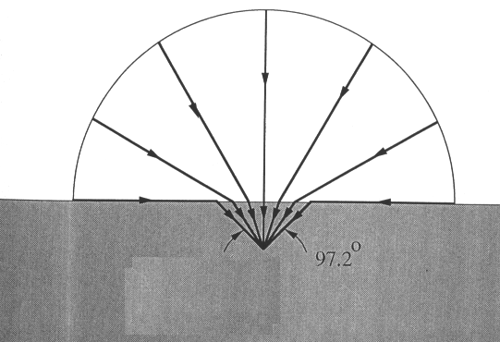
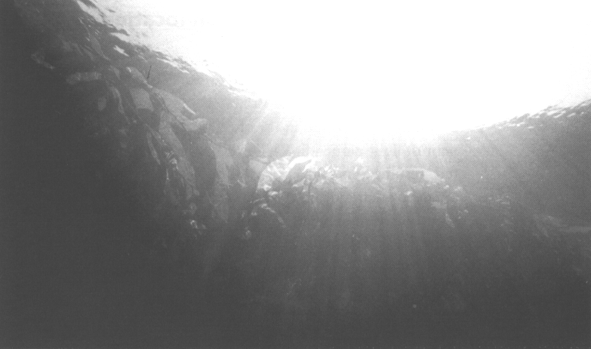
Examples: refraction at water/air interface
Diver’s illusion
97º
Diver sees all of horizon
refracted into a 97°cone

Slide 12

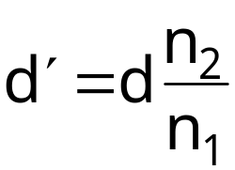
Apparent Depth (表观深度)
Apparent depth:
n₂
n₁
d′
apparent fish
d
actual fish
50

Slide 13



Wow look at the variation in index of refraction!
Which is red? n smaller
Which is blue?
Skier sees blue coming up from the bottom (1), and red coming down from the top (2) of the rainbow.
Blue light is deflected more!

Slide 14
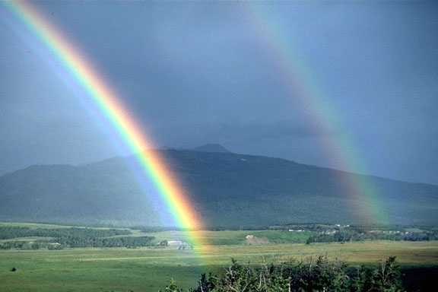
LIKE SO!
In second rainbow pattern is reversed

Slide 15
2. Total Internal Reflection(全反射)
  Consider light moving from glass (n₁=1.5) to air (n₂=1.0)
incident
ray
reflected
ray
n₁
θ₁
θ_{r}
GLASS
n₂
θ₂
AIR
I.e., light is bent away from the normal.
as θ₁ gets bigger, θ₂ gets bigger, but θ₂ can never get bigger than 90° !!
refracted
ray
2
In general, if sin θ₁ > (n₂ / n₁), we have NO refracted ray;
we have TOTAL INTERNAL REFLECTION.
For example, light in water which is incident on an air surface with angle θ₁ > θ_{c} = sin⁻¹(1.0/1.5) = 41.8° will be totally reflected. This property is the basis for the optical fibers used in communication.

Slide 16
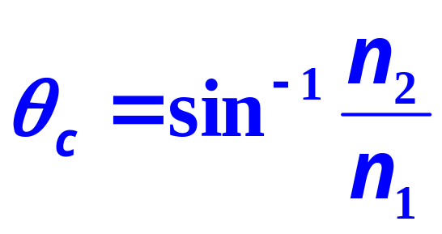
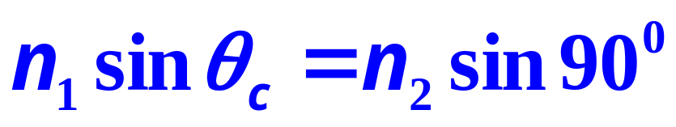
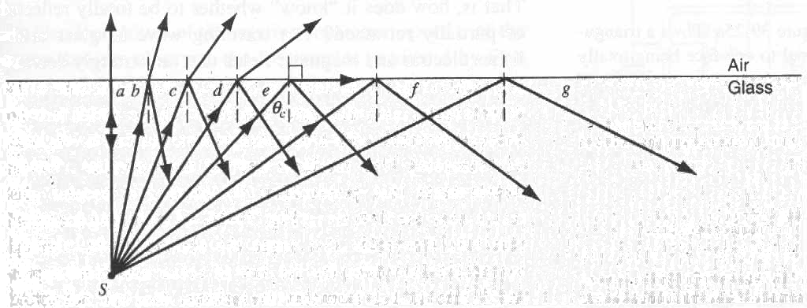

Slide 17
Recall Snell’s Law: n₁ sin(θ₁)= n₂ sin(θ₂)
(n₁ > n₂ ⇒ θ₂ > θ₁ )
θ₁ = sin⁻¹(n₂/n₁) then θ₂ = 90
“critical angle”
θ₂
Light incident at a larger angle will only have reflection (θ_{i} = θ_{r})
n₂
θ_{r}
n₁
θ_{i}
θ_{c}
θ₁
normal

Slide 18
Optical fiber (光纤):
At each contact the glass air interface, if the light hits at greater than the critical angle, it undergoes total internal reflection and stays in the fiber.
n_{outside}
n_{inside}
Telecommunications(通信)
Arthroscopy(内窥镜检查)
Laser surgery(激光手术)
Total Internal Reflection only works if n_{outside} < n_{inside}

Slide 19
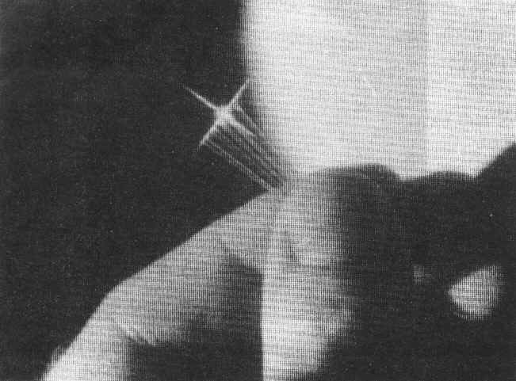
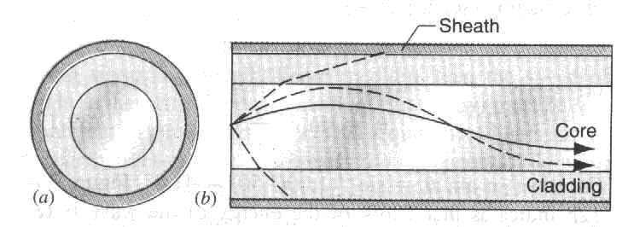

Slide 20
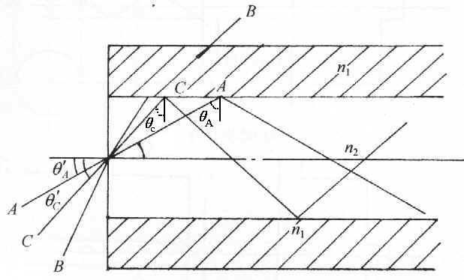
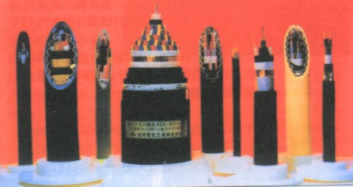

Slide 21
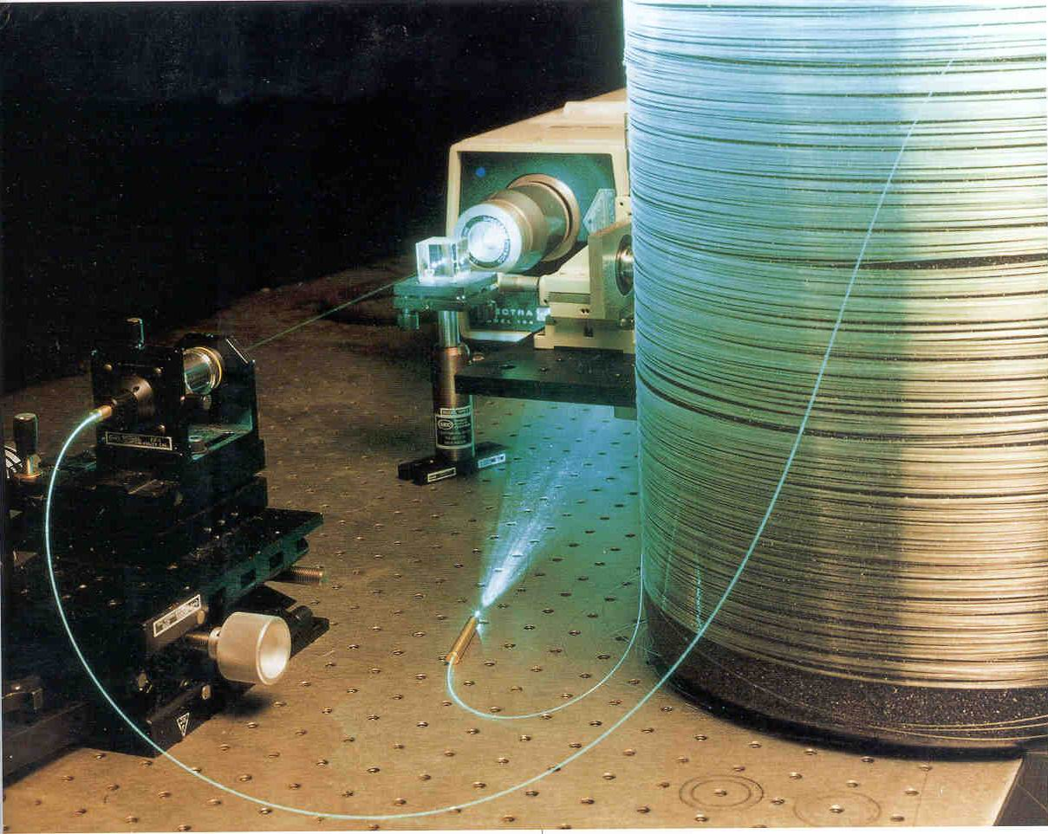

Slide 22
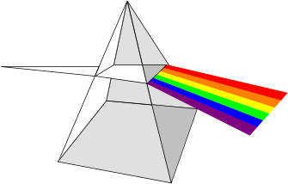
3. Dispersion (色散)
1.54
ultraviolet
absorption
bands
Ultraviolet absorption bands cause a rising index of refraction in the visible
Index of refraction
1.52
1.50
frequency
white light
prism
Split into Colors

Slide 23
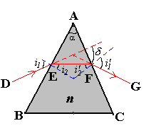
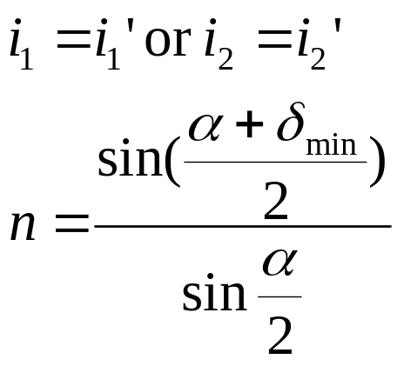
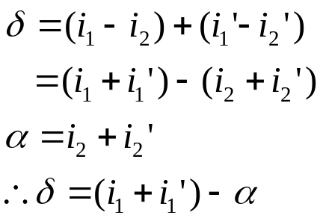
A Prism (棱镜)
Changing i₁, there is smallest angle δ
The condition is:
The measurement of index of refraction for the prism.

Slide 24
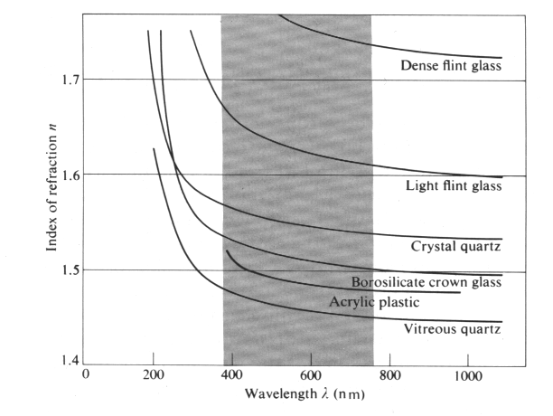
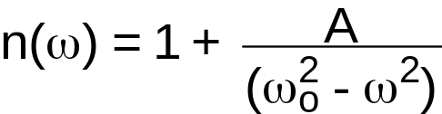
Dispersion in more detail:
Effects of wavelength dependence of n
Dispersion: n depends on wavelength!
In many “dielectric” materials like glass, the characteristic ω_{o} is in the ultraviolet
n_{blue} > n_{red}
Dense flint glass: (重火石玻璃)
Light flint glass: (轻火石玻璃)
Crystal quartz:
Borosilicate crown glass (硅酸硼冕牌玻璃)
Acrylic plastic (丙烯塑料)
Vitreous quartz
v_{blue} < v_{red}

Slide 25
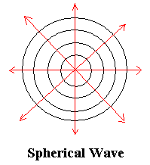
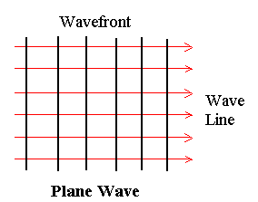
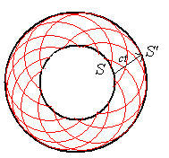
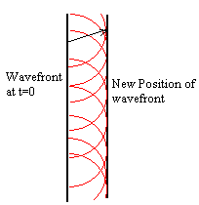
40-2 Huggen’s Principle(惠更斯原理)
All points on a wave-front(波前) can be considered as point sources for the production of spherical secondary wavelets (子波). After a time t the new position of a wave-front is the surface tangent to the secondary wavelets.

Slide 26
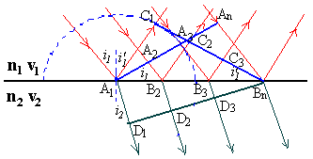
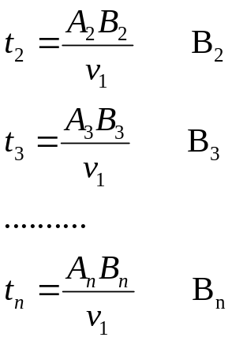
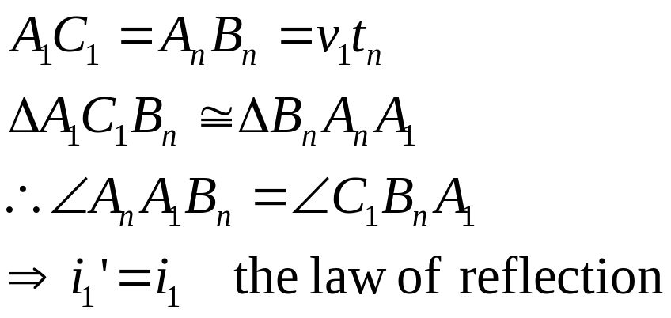
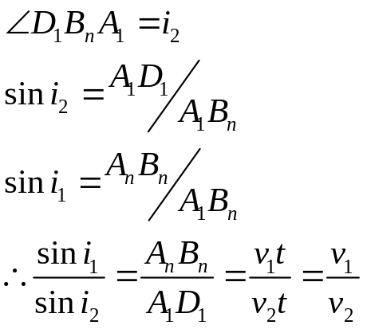
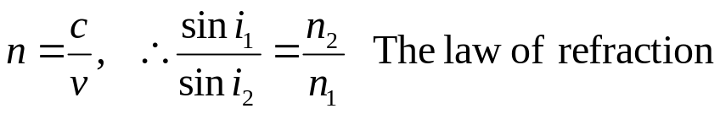
Deriving the of Reflection and Refraction by Huygen’s Principle

Slide 27
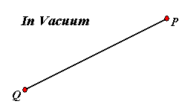
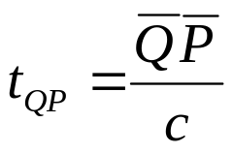
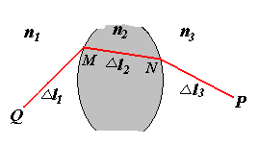
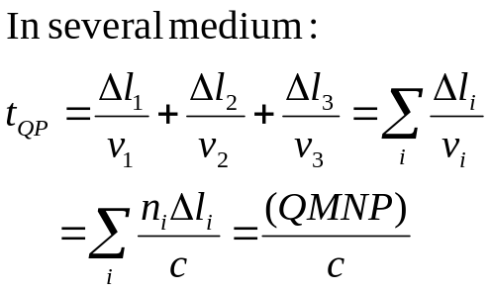
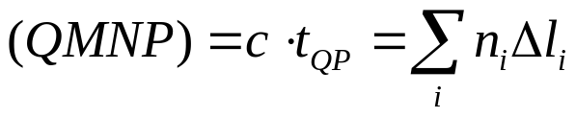
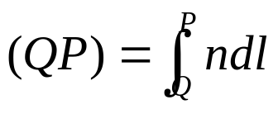
40-3 Fermat’s Principle(费马原理)
1. The Optical Path Length (光程)
The optical path length:

Slide 28
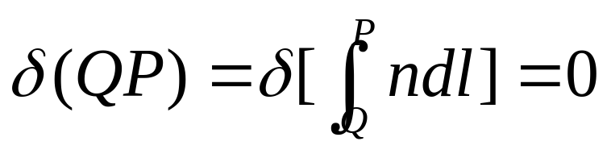
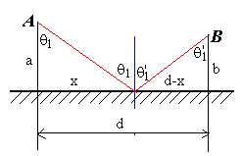
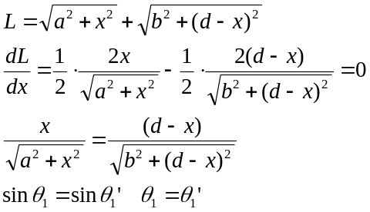
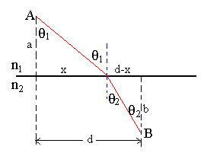
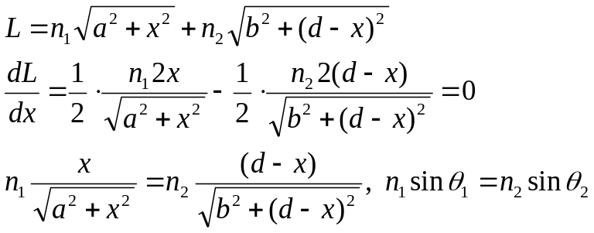
2. The Fermat’s Principle (费马原理)
A light ray traveling from one fixed point to another fixed points follows a path such that, compared with nearby paths, the time required is either a minimum, or a maximum or remains unchanged. (that is stationary)
3. Deriving the law of reflection and refraction.

Slide 29
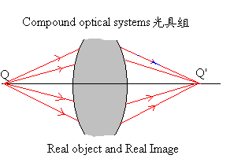
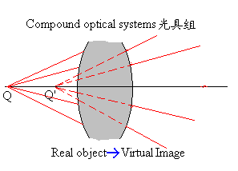
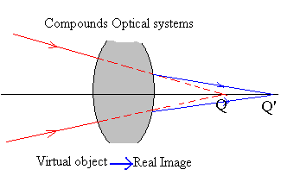
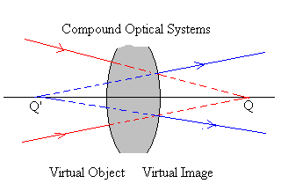
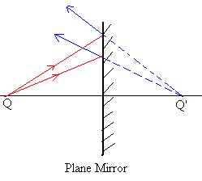
40-4 Image Formation (成像)
Real and Virtual Image (实像和虚像)
Real and Virtual Object(实物和虚物)

Slide 30
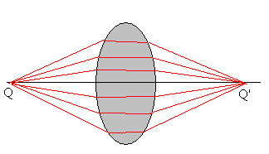
2. Equivalent Optical Path (等光程)
3. Object side (物方), Image Side (像方)

Slide 31







40-5 Image Formation by Spherical Mirror
Refraction on a spherical surface:

Slide 32



Cont.
This result indicates that object Q point can not be imaged into Q’ point through a spherical surface.
There are only two cases that Q point can be imaged into one point Q’:
o, and i are determined at same time. For one
spherical surface, there is only one group points. (齐明点)
Another case is for paraxial rays (傍轴近似)

Slide 33





2. Image Formation Equation
For paraxial rays (傍轴光线):
For any Q point (object distance o, there is image Q’ point (image distance i ).
The first focal point:
The second focal point:

Slide 34


3. Sign Conventions
(符号约定)
If we suggest that the incident light ray from left to right.
If the Q point is at the left of A point (实物) o>0
If the Q point is at the right of A point (虚物) o<0
(2) If the Q’ point is at the left of A point (虚像) i<0
If the Q’ point is at the right of A point (实像) i>0
(3) If the C point (球心）is at the left of A point， r<0
If the C point (球心）is at the right of A point，r>0

Slide 35







For the reflection at the surface of a mirror
(2‘) If the Q’ point is at the left of A point (实像), i >0
If the Q’ point is at the right of A point (虚像), i <0

Slide 36




4. The image formation of paraxial object point and lateral magnification
(傍轴物点成像和横向放大率)
Paraxial Ray: y², y’²<<o²,i²,r²
Sign convention: (4) If P (or P’) is above the light axis, y (or y’)>0
If P (or P’) is below the light axis, y (or y’)<0
Lateral Magnification:
For the reflection:

Slide 37







5. Image Formation of Compound Optical System
Lagrange-Helmholtz Law

Slide 38










40-6 Thin Lens (薄透镜)
In most refraction situation there is more than one refracting surface.
1. The formula of focal length(焦距) f.

Slide 39



Lens maker’s Equation
(磨镜者公式)
If n=n’=1

Slide 40
If f>0, f’>0 Converging lens (凸透镜)
A lens that is thicker at the center than at the edges.
If f<0, f’<0 diverging lens
(凹透镜)
A lens that is thicker at the edges than at the center.

Slide 41




2. The Image Formation Formula
If n=n’, f=f’
Gauss’ Form
Sign Convention:
(6) If Q is at the left of F point, x>0
If Q is at the right of F point, x<0
(7) If Q’ is at the left of F’ point, x’<0
If Q’ is at the right of F’ point, x’>0
Newton’s Form:

Slide 42





Lateral Magnification (横向放大倍数)
For example:
Diopter, D (屈光度)
200度

Slide 43
3.Compound Optical Systems
A single mirror or lens is seldom a useful optical device.
A combination of several lenses or mirrors.
Binocular
Telescopes
Microscopes
Cameras
Eyes

Slide 44
Hubble Space Telescope
The HST was launched in 1990; it was discovered that a lens had been ground incorrectly, so all images were blurry!
A replacement “contact lens”, COSTAR, was installed in 1993.
(Now, Hubble’s instruments have built-in corrective optics, so COSTAR is no longer needed.)

Slide 45


Hubble Space Telescope
Aperture of primary mirror: 2.4 m
Mass of primary mirror: 828 kg
Before COSTAR
After COSTAR

Slide 46
Amazing Eye(神奇的眼睛)
One of first organs to develop.
100 million Receptors 4 million
  200,000 /mm² 2,500 /mm²
  Sensitive to single photon!
Candle from 12 miles
Ciliary Muscles
Notes:
Numbers in red are for a digital camera
Macula/fovea is super sensitive part only sees about 15 degrees
http://hyperphysics.phy-astr.gsu.edu/hbase/vision/retina.html#c2

Slide 47
ACT: Focusing and the Eye
Cornea(角膜) n= 1.38
Lens(晶状体) n = 1.4
Vitreous(玻璃体) n = 1.33
Retina(视网膜)
Cones(园锤细胞)
Pupil(瞳孔)
Ciliary Muscles
Which part of the eye does most of the light bending?
1) Lens 2) Cornea 3) Retina 4) Cones
Lens and cornea have similar shape, and index of refraction. Cornea has air/cornea interface 1.38/1, 70% of bending. Lens has Lens/Vitreous interface 1.4/1.33. Lens is important because it can change shape.
Laser eye surgery changes Cornea

Slide 48






Eye (Relaxed)
Example
25 mm
Determine the focal length of your eye when looking at an object far away.
Object is far away:
Want image at retina:

Slide 49




Eye (Tensed)
Example
250 mm
25 mm
Determine the focal length of your eye when looking at an object up close (25 cm).
Object is up close:
Want image at retina:

Slide 50
Near Point, Far Point
Eye’s lens changes shape (changes f )
  Object at any d_{o} can have image be at retina (d_{i} = approx. 25 mm)
Can only change shape so much
“Near Point”
  Closest d_{o} where image can be at retina
  Normally, ~25 cm (if far-sighted then further)
“Far Point”
  Furthest d_{o} where image can be at retina
  Normally, infinity (if near-sighted then closer)

Slide 51



If you are nearsighted(近视眼)...
(far point is too close)
Example
Too far for near-sighted eye to focus
d_{o}
d_{far}
Near-sighted eye can focus on this!
Contacts form virtual image at far point – becomes object for eye.
Want to have (virtual) image of distant object, d_{o} = ∞, at the far point, d_{i} = -d_{far}.
f_{lens} = - d_{far}

Slide 52




If you are farsighted(远视,老花)...
(near point is too far)
Example
Too close for far-sighted eye to focus
d_{o}
d_{near}
Far-sighted eye can focus on this!
Want the near point to be at d_{o}.
Contacts form virtual image at near point – becomes object for eye.
When object is at d_{o}, lens must create an (virtual) image at -d_{near}.

Slide 53



Unaided Eye (裸眼)
How big the object looks with unaided eye.
object
h₀
θ
N
Bring object as close as possible (to near point N)
**If θ is small and expressed in radians.

Slide 54




Magnifying Glass
magnifying glass
virtual image
object
h_{i}
h_{o}
d_{o}
d_{i}
Magnifying glass produces virtual image behind object, allowing you to bring object to a closer d_{o}: and larger θ’
Compare to unaided eye: :
Ratio of the two angles is the angular magnification M:

Slide 55




Angular Magnification M=N/d_{o}
magnifying glass
virtual image
object
(N = near point distance from eye.)
h_{i}
h_{o}
d_{o}
d_{i}
For max. magnification, need image at N:
so set d_{i} = -N:
=
d_{i} < -N
∴ M lies between
and the shorter the
focal length, the greater the magnification M.
M = 25/10 + 1 = 3.5

Slide 56
Homework
Exercises Page 934, 17, 20,
Problem Page 937, 5, 7, 12

